Slide 1
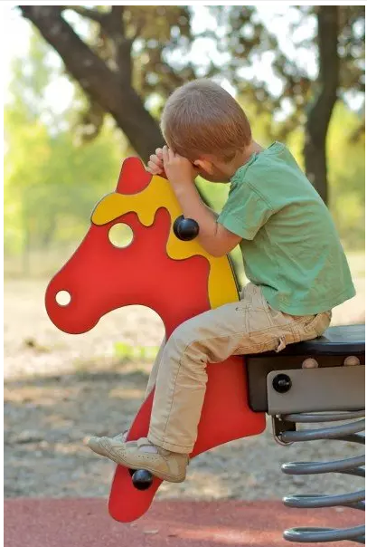
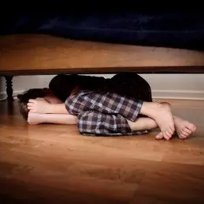
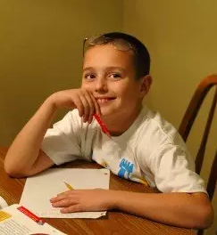
Autism Spectrum Disorder
PSYNEURGY
ψ
PHARMACEUTICALS
Austin Horton
Notes:
My name

